Slide 1
start
display
welcome
Display
1. Estimated time duration to complete your work
2. Do you want to reduce your sleeping hours, If you wish to reduce the time duration (yes/no)
Calculate
number of days needed to complete the work (Updated)
Input
1. your modules
2. free hours per each day of the week
3. Average sleeping hours per day
4. Work load(how many lecture recordings, no of pdf pages) in each module
Display
Estimated new time duration to complete your work
if
use system("PAUSE");
Display
Hit enter to view the designed study plan
NO
Calculate
Number of days needed to complete the work
YES
Display
The computed study plan
Good luck!
Input
Updated sleeping hours
End

Slide 2
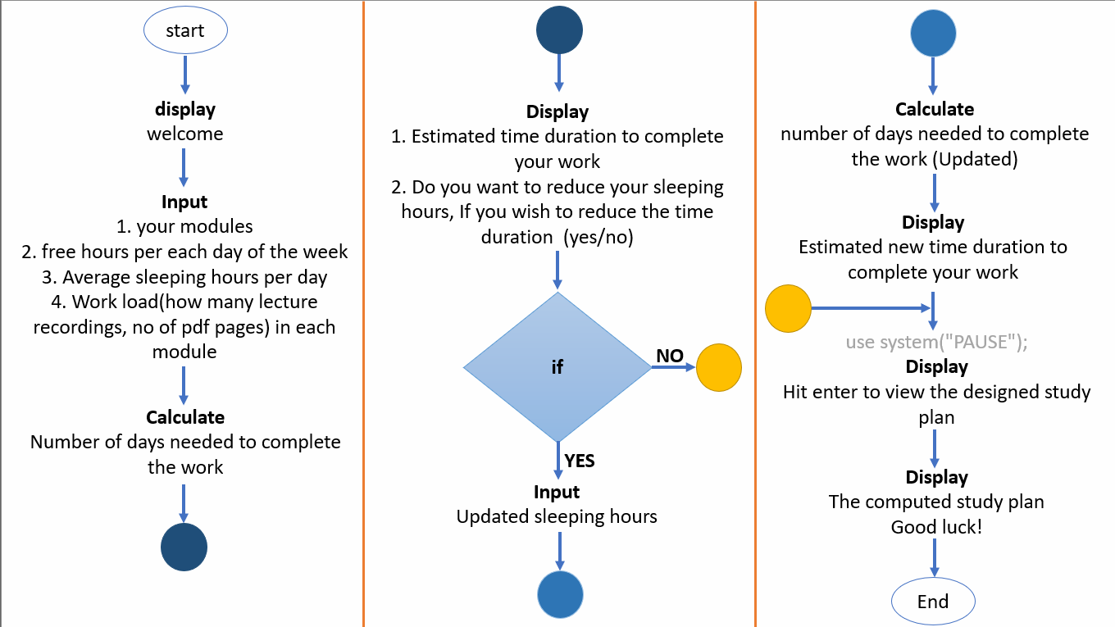

Slide 3
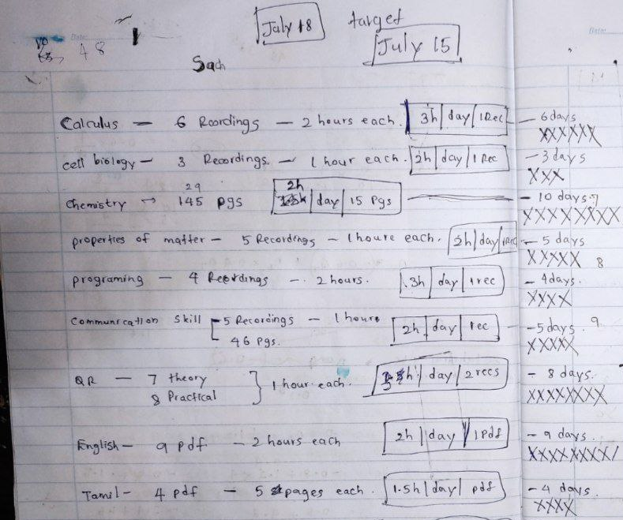
Further Implementations
Enable to go back and customize the previously entered data
Enable customization of sleeping hours unlimited times
Enable to choose degree and semester
Enable instant update upcoming days

Slide 4
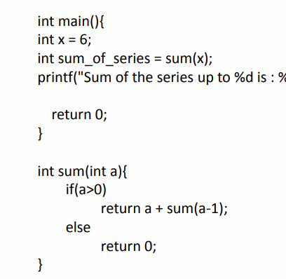
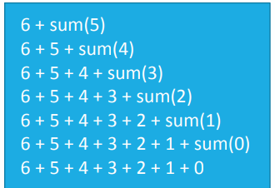
6 + sum(6-1)
5+ sum(5-1)
4 + sum(4-1)
3 + sum(3-1)
2 + sum(2-1)
1 + sum(1-1)
0
10 + sum(10+1)

Slide 5
PROGRAM : Study plan generator
DISPLAY “welcome to the study plan generator”
DISPLAY “Tips : You must Hit Enter after each data entry”
READ
z = 0, C =0, tH = 0, modCount = 1
DO
WHILE input = y or Y

Slide 6
